Slide 1
新生精神康復會
NEW LIFE
Psychiatric Rehabilitation
Association

Slide 2
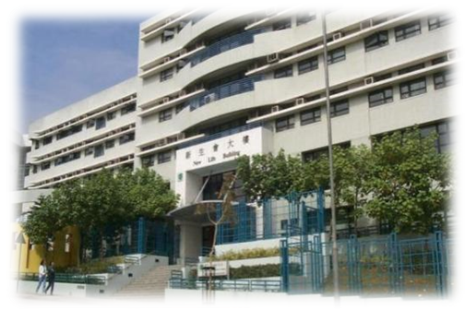
New Life Profile
A non-profit organization (evolved from a mutual aid club in 1959) specializing in Mental Health
Established in 1965, incorporated under the Companies Ordinance Act in 1969 and became a member of Community Chest in 1970
Supporting the two-pronged Mental Health policy of HKSAR Government: Promoting mental health to the general public AND providing quality, affordable and accessible mental health services for persons in need [Para. 13, Mental Health Review Report (2017), FHB]
Serving about more than 16,000 PIR & their families and about 90,000 general public in a year
> $609 million annual income
> 1,300 staff members
Multifarious services: subvented services (mainly by SWD); other government funded services; donated projects; self-financing services & projects; and social enterprises (New Life Support Enterprises Limited (NLSEL))
Evidence-based approach: emphasis on pilot schemes, research, training and development
Multi-partner model: many partners in different types of projects
A leading NGO in mental health

Slide 3
Our Vision and Mission

Slide 4
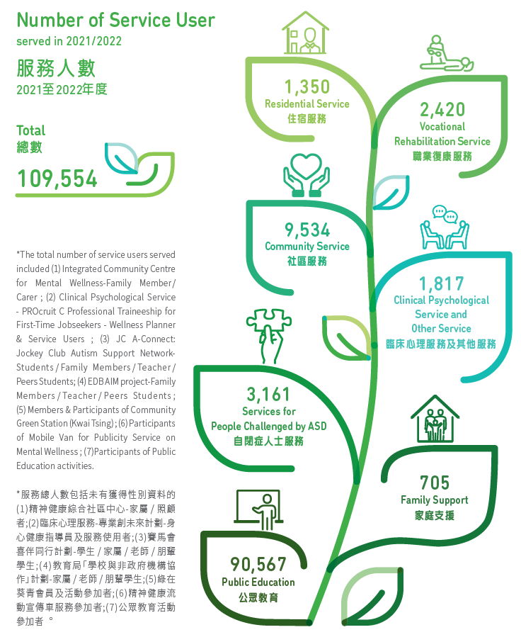
Our Services

Slide 5
Programme Worker (U-Links)
To support professional staff in service delivery, including groups and programs, outreaching
Locations
Tuen Mun,
Service Units
Integrated Community Centre for Mental Wellness
To provide administrative support to the unit
To support in ad hoc duties assigned
Duties
Tin Shui Wai,
Wong Tai Sin,
Yau Tsim Mong,
Kwai Chung,
Ap Lei Chau,
Shek Pai Wan,
Shatin,
Island
Mobile Van Project
Halfway Houses
Self-supported Hostel
Sheltered Workshops/ Integrated Work Centres
Requirement: HD/Associate Degree or Above

Slide 6
To apply
Applicants are invited to forward a cover letter and a resume to the Human Resources Department by post at New Life Psychiatric Rehabilitation Association, 332 Nam Cheong Street, Kowloon, or by fax at 3552 5398, or by email to recruit@nlpra.org.hk.
Applicants could indicate their preference of services in the application.

